Slide 1

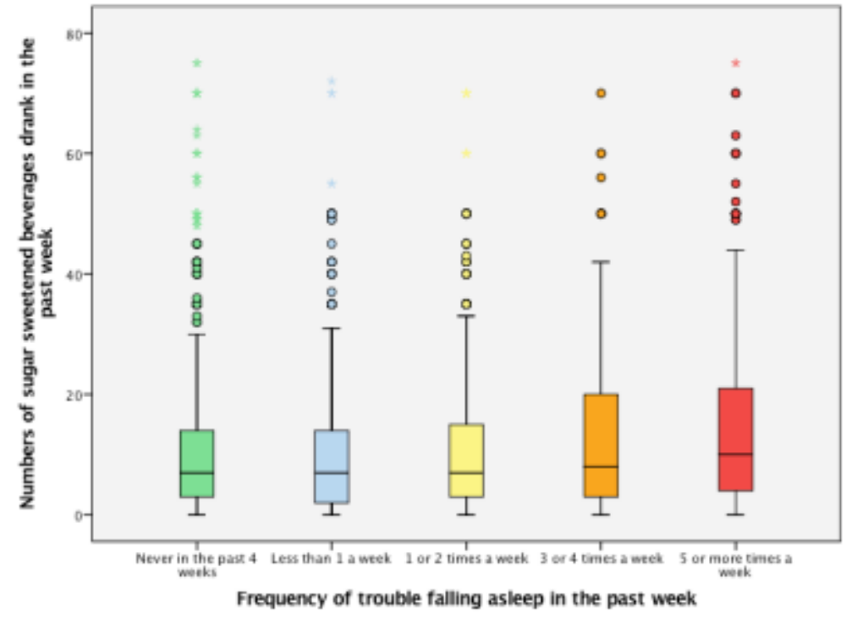
The Association between Sugar-Sweetened Beverages Consumption & Sleeping Quality among Gender
Chia Hsuan, Cho
Math 615, California State University, Chico, 2017
INTRODUCTION
Consumption of sugar-sweetened beverages (SSBs) such as sodas, fruit-flavored drinks, and sport drinks is a major contributor to health problems (Vansanti, et al., 2010). Other than physical health issues, lifestyle-related behaviors, such as poor diet habits, smoking, physical inactivity and inadequate sleep, could also be affected. To maintain good health, sleep is essential. Sleeps plays a key role in helping students to fix and consolidate memories, plus to prevent decay of memories. It is critical to obtain seven to eight hours of sleep per night for adults to maintain an optimum health and wellbeing. However, a cross-sectional study stated that higher consumption of energy drinks, caffeinated beverages, and other stimulants have a strong association with poor sleeping patterns and qualities (Casills, 2012). Also, females tend to have poorer sleep quality compared to males. Studies have been looking into sugar-sweetened beverages consumption and sleep duration. But there is lacking of studies that investigate whether the consumption of sugar-sweetened beverages would result in trouble falling asleep.
HYPOTHESIS
As the consumption of sugar-sweetened beverages increases, the harder for a person to fall asleep.
Females tend to have harder times falling asleep than males after consuming sugar-sweetened beverages.
As the consumption of sugar-sweetened beverages increases, people tend to snore and stop breathing during sleep.
SAMPLE CHARACTERISTICS
RESULTS
Table 1. Sample Characteristics
 |  |  |  | n | %
Gender
 | Male |  |  | 3147 | 48.4
 | Female |  |  | 3356 | 56.6
Sugar Sweetened Beverages drank in the past week
 | <21 drinks |  |  | 4401 | 86.1
 | >21 drinks |  |  | 713 | 13.9
Trouble falling asleep in the past 4 weeks
 | Never |  |  | 2400 | 46.9
 | <1 |  |  | 950 | 18.6
 | 1 to 2 |  |  | 911 | 17.8
 | 3 to 4 |  |  | 395 | 7.7
 | >5 |  |  | 411 | 8
Snore and stop breathing during sleep
 | No |  |  | 2595 | 50.8
 | Yes |  |  | 2458 | 48.1
 |  |  |  | Mean | SD
Sugar-Sweetened Beverages drank in the past week |  |  |  | 14.22 | 49.7
Table 3. Frequency of trouble falling asleep regarding sugar-sweetened beverages consumption by Gender
 |  |  | Male |  | Female
 |  |  | Mean (SD) |  | Mean (SD)
Frequency of trouble falling asleep in the past month
 | Never |  | 12.85(12.64)ª |  | 9.01 (10.0)ª
 | <1 time a week |  | 11.39 (11.46)ª |  | 8.89 (10.22)ª
 | 1 or 2 times a week |  | 12.7 (12.70)ª |  | 10.36 (11.04)ª
 | 3 or 4 times a week |  | 14.94 (12.78)ª |  | 11.73 (13.02)^{b}
 | >5 times a week |  | 17.22(15.35)^{b} |  | 13.35 (13.75)^{c}
P-value |  |  | <0.001* |  | <0.001*
*p-value: <0.05
^{a,b,c} Frequency of trouble falling asleep means for given variable sharing the same superscript are not significantly different from each other
An ANOVA test was used to determine the association of sugar-sweetened beverages consumption between frequencies of difficulties falling asleep. The ANOVA test showed that at least one of the groups is significantly different (F=14.61, p<0.001).
The model was stratified by the variable “gender”. Both the original and stratified models are highly significant. Thus, gender is not a moderating variable for the relationship.
Table 1 presents the variable that was used in the study. Gender is the main variable that was used. Male and females are evenly distributed in the study. However, there is slightly more females (56.6%) than males (48.4%). That study mainly focused on sugar-sweetened beverages consumed in the past week and sleep quality. The continuous variable of sugar-sweetened beverages consumption has a mean of 14.22 and standard deviation of 49.7. When the variable is dichotomized into less than or equal to 21 drinks a week and more than 21 drinks a week, most of the respondents were reported to drink less than 21 drinks in a week (86.1%). The association of sleep quality was investigated on frequency of trouble falling asleep in the past month and if snore and stop breathing during sleep. It showed that 46.9% of the participants did not have trouble falling asleep, but with 8% reported to have more than 5 times for the past month. Also, most of the participants reported to not snore and stop breathing during sleep.
Conclusion
From Figure 1, the results significantly (p<0.01) showed that as the increase in sugar-sweetened beverages consumption, the harder it is for the participants to have trouble falling asleep (mean=14.83). As compared to those who never or less than 1 times a week to have trouble falling asleep in the past 4 weeks, the SSBs consumption is lower (mean=10.92 and 9.95). Both gender showed not to be a significant moderator to the association with p-values <0.01. After performing a Post Hoc test, it showed a significant between those who have never trouble falling asleep (Male: mean=12.85; Females: mean= 9.01) and those who have trouble falling asleep more than 5 times a week (Male: mean=17.22; Female: mean=13.35).
RESULTS
IMPLICATIONS
Sleep in the key component to mental health. As from the results, as the increase in consumption in sugar-sweetened beverages, the frequency of trouble falling asleep increases. When sleep quality decreases, people would not be able to stay alert with the tasks for the following day. Thus, future research should focus on the time when the sugar-sweetened beverages are consumed and how they would effect on people’s quality of sleep.
METHODS
This study was a cross-sectional observational study. The study tool was a survey questionnaire obtained from CDC Add Health Public Use File 2008-2009. The study participants were respondents aged between 24 to 32. The independent variables measured were numbers of sugar-sweetened beverages consumed in the pass week (continuous) and the dichotomize into less than 21 drinks and more than 21 drinks in a week. The dependent variable was frequency of trouble falling asleep (interval) and whether snore or stop breathing during sleep (binary categorical). Gender was test if they are the confounder or moderator to the relationship.
Data was analyzed using IBM Statistical Package for the Social Science [SPSS Statistics] version 24. Results were considered statistically significant if the p-value obtained was less than 0.5. Descriptive statistics were used to characterize the general demographic characteristics of the sample and survey responses.
REFERENCES
1. Casillas, G., et al. (2012). Sleep quality and sleep patterns in relation to consumption of energy drinks, caffeinated beverages, and other stimulants among Thai college students. Springer-Verlag Berlin Heidelberg 2012. Sleep Breath (2013) I7:1017-1028.
2. Velez, J., et al. (2013). The epidemiology of sleep quality and consumption of stimulant beverages among Patagonian Chilean college students. Sleep disorders. ID 910104.
3. Cauter, E. Knutson, K. Sleep and the epidemic of obesity in children and adults. 2008. European Journal of Endocrinology. 159 S59-S66. ISSN 0804-4643.
4. Ebbeling, Cara., et al. (2012). A randomized trial of sugar-sweetened beverages and adolescent body weight. The New England Journal of medicine. 367:1407-16.
Figure 1. One-way ANOVA was conducted. There does seem to be a significant difference between groups (p-value <0.001). Thus, the hypothesis is rejected. After conducting the Post Hoc test, the results showed significant between never have trouble fall asleep and 3 or 4 times in the past month (p=0.01) and more than 5 times in the past month (p<0.01).
ACKNOWLEDGEMENT
ccho5@mail.csuchico.edu

